Slide 1
Course: Cloud, Microservices and Applications
UNIT II: Virtualization
SESSION 7
Introduction
Date: 28/7/2021

Slide 2
What is Virtualization?
Virtualization is a large umbrella of technologies and concepts that are meant to provide an abstract environment—whether virtual hardware or an operating system—to run applications.
The term virtualization is often synonymous with hardware virtualization, which plays a fundamental role in efficiently delivering Infrastructure-as-a-Service (IaaS) solutions for cloud computing.

Slide 3
Virtualization technologies have gained renewed interested recently due to the confluence of several phenomena:
Increased performance and computing capacity
Underutilized hardware and software resources
Lack of space
Greening initiatives
Rise of administrative costs

Slide 4
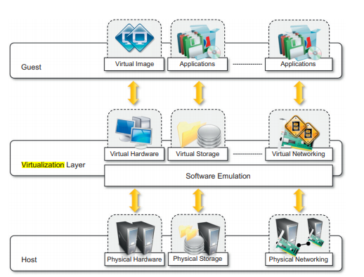
The virtualization reference mode
Image SOurce: Rajkumar Buyya, S. Thamarai Selvai, “Mastering Cloud computing and application programming”,1st Edition, Elsevier, 2013

Slide 5
Any Questions???

Slide 6
Thank You

